Slide 1
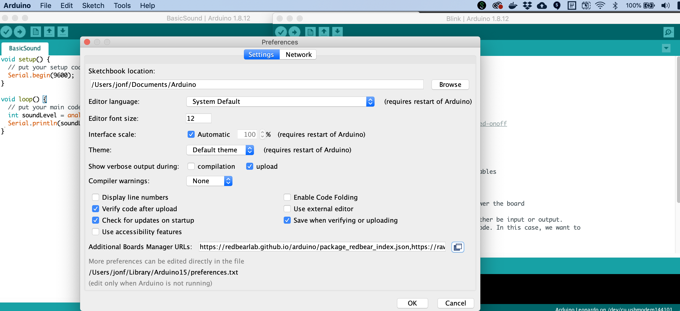

Slide 2

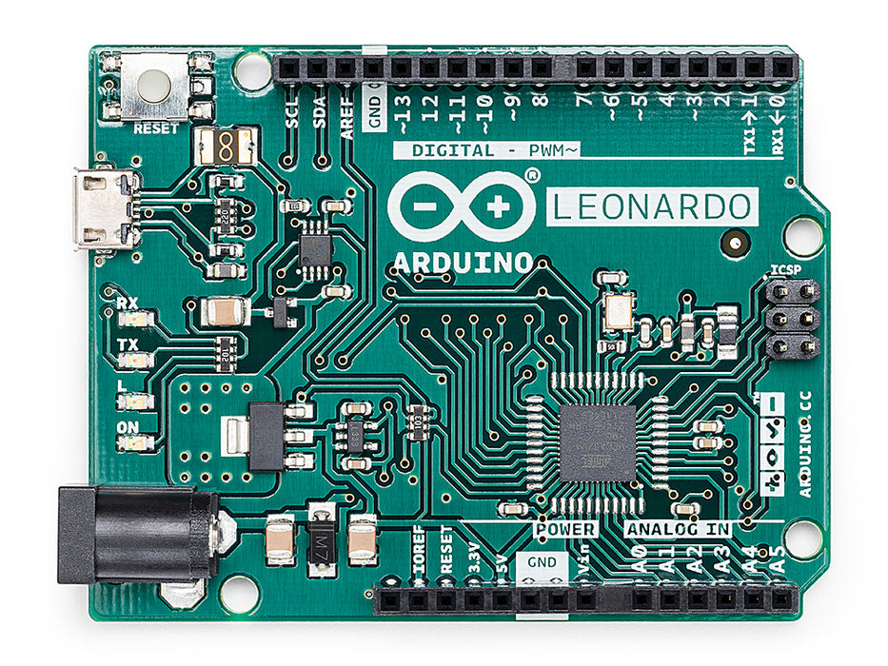
Arduino Uno
Arduino Leonardo

Slide 3
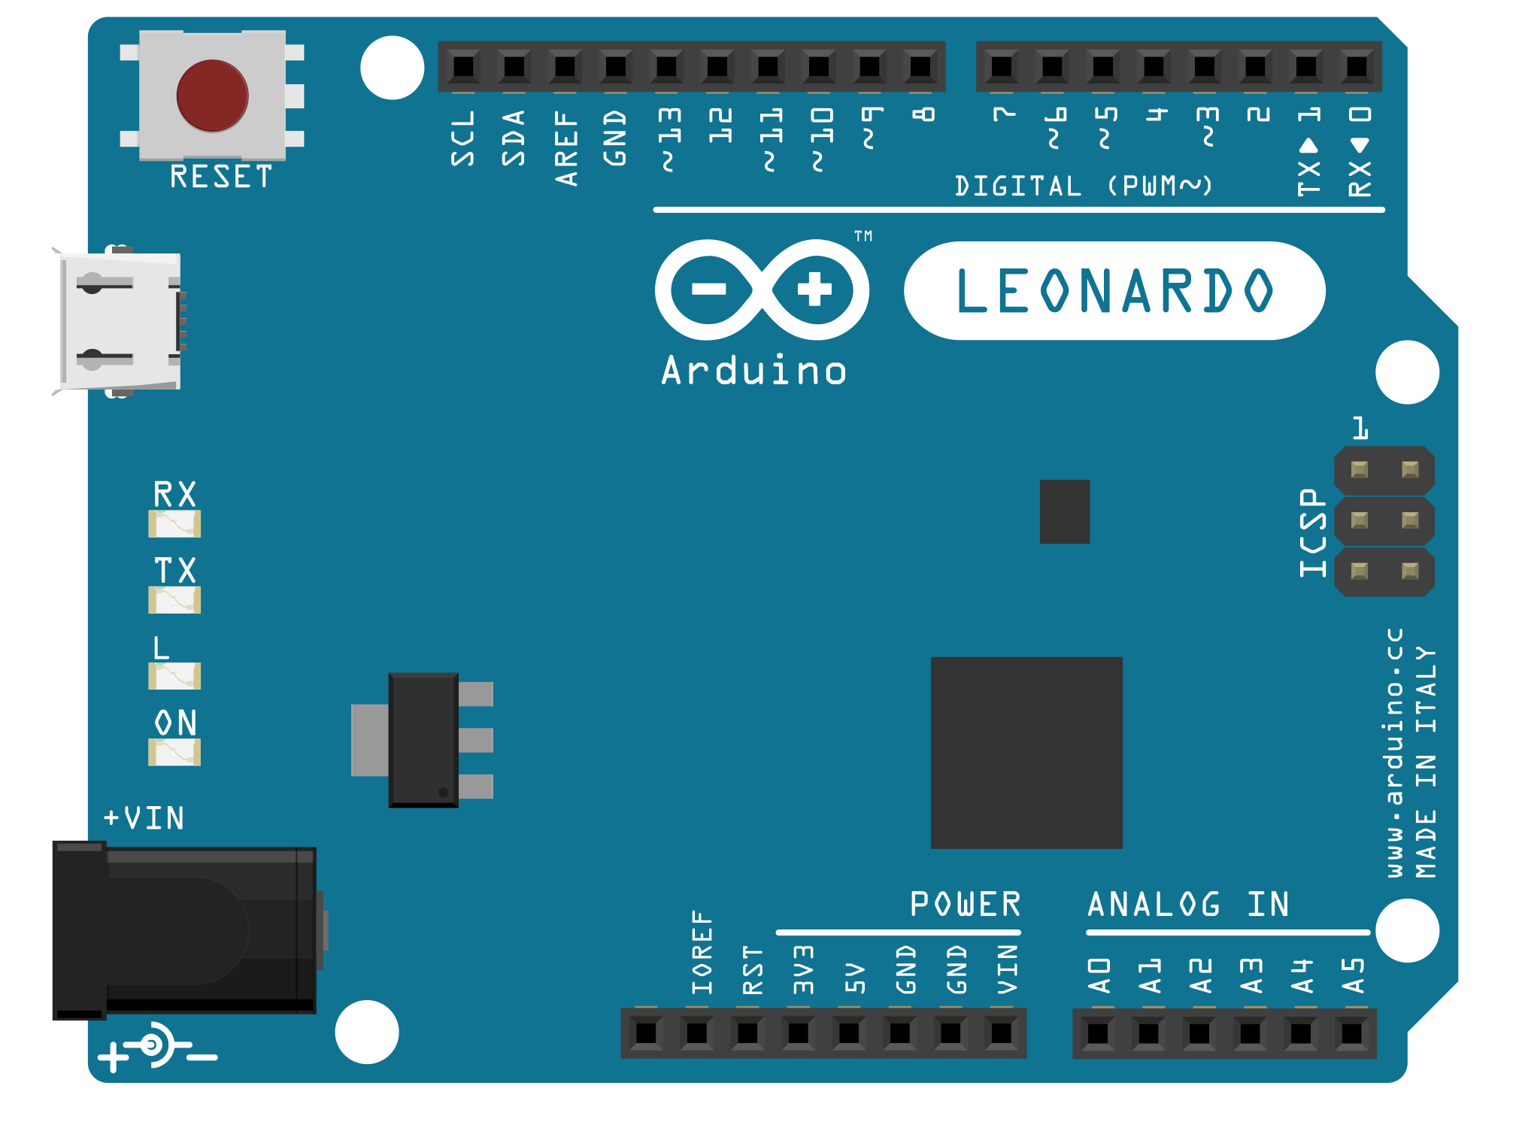

Slide 4
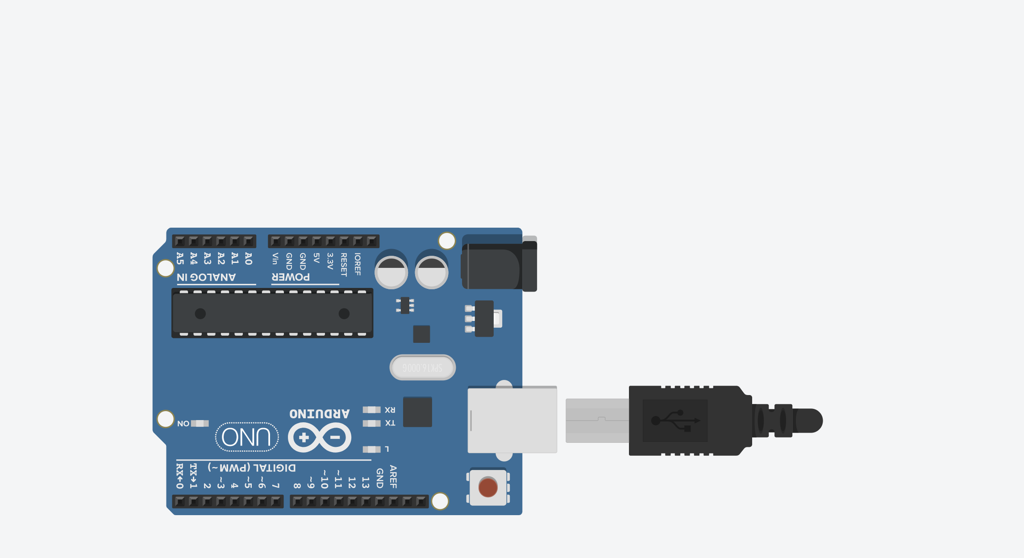
GND
5V
3.3V

Slide 5
Digital I/O Pins
The Arduino Uno has 14 digital input/output (I/O) pins, which can be used to read or write digital information via the digitalRead and digitalWrite commands, respectively.

Slide 6
Analog Output Pins
The Arduino Uno has 6 analog output pins indicated by the tilde ~, which can output a voltage signal between 0 and 5V using PWM via the analogWrite command

Slide 7
Six Analog Output Pins
The Arduino Uno has 6 analog output pins indicated by the tilde ~, which can output a voltage signal between 0 and 5V using PWM via the analogWrite command
Six Analog Input Pins
The Arduino Uno has 6 analog input pins, which can read a voltage signal between 0-5V using the analogRead command

Slide 8
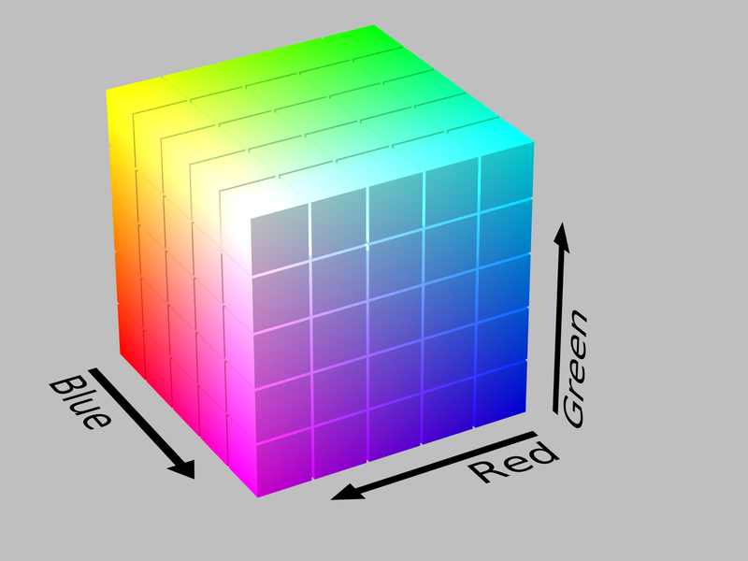
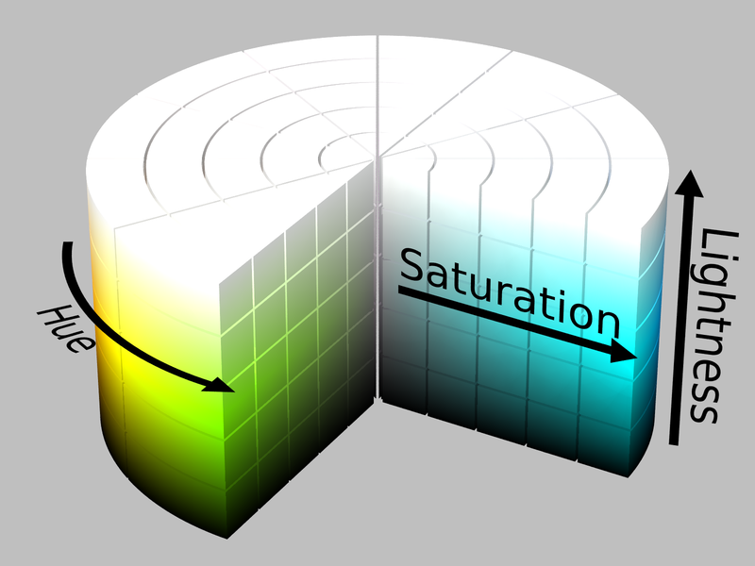
RGB Color Space
HSL Color Space
Example Values
Typically represented by (R, G, B):
Red: 0-255, Green: 0-255, Blue: 0-255
Typically represented by (H, S, L):
Hue: 0-360°, Saturation: 0-1.0, Lightness: 0-1.0
Though sometimes Hue is also 0-1.0.
RGB: 0-255, 0-255, 0-255
Red: 255, 0, 0
Green: 0, 255, 0
Blue: 0, 0, 255
Yellow: 255, 255, 0
Violet: 255, 0, 255
Cyan: 0, 255, 255
Pink: 255, 192, 203
RGB Hex code
#FF0000
#00FF00
#0000FF
#FFFF00
#FF00FF
#00FFFF
#FFC0CB
HSL: 0-1.0, 0-1.0, 0-1.0
0.0, 1.0, 0.5
0.33, 1.0, 0.5
0.66, 1.0, 0.5
0.164, 1.0, 0.5
0.835, 1.0, 0.5
0.498, 1.0, 0.5
0.972, 1.0, 0.878

Slide 9
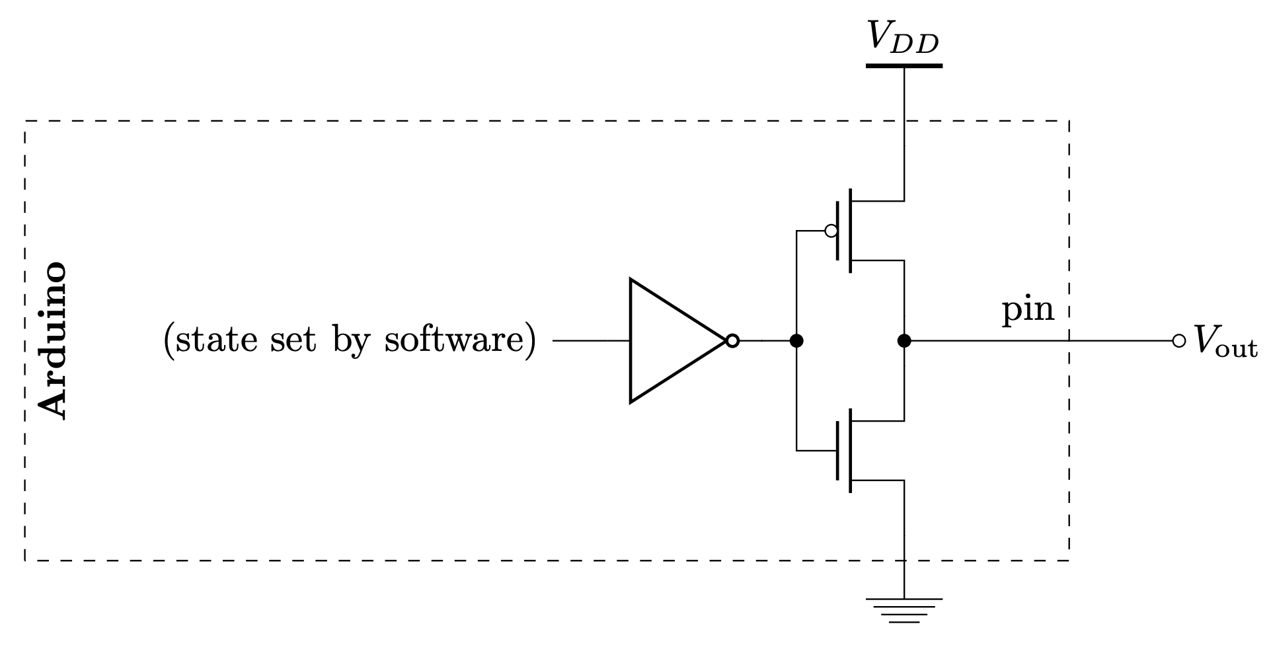
GND
Notes:
From: https://web.stanford.edu/class/archive/engr/engr40m.1178/slides/arduino.pdf
See also: https://web.stanford.edu/class/archive/engr/engr40m.1178/slides_sp17/arduino-io.pdf

Slide 10
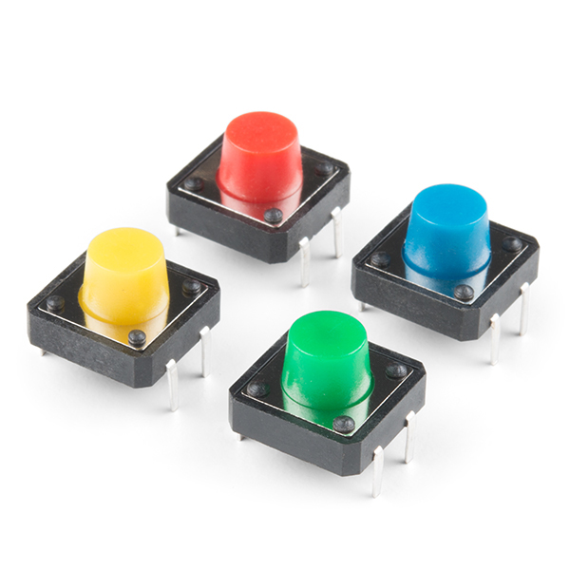
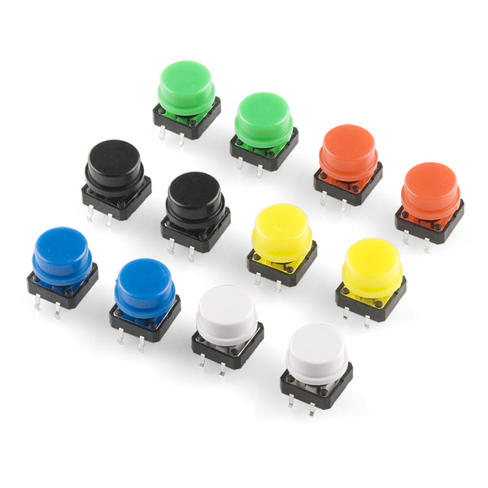
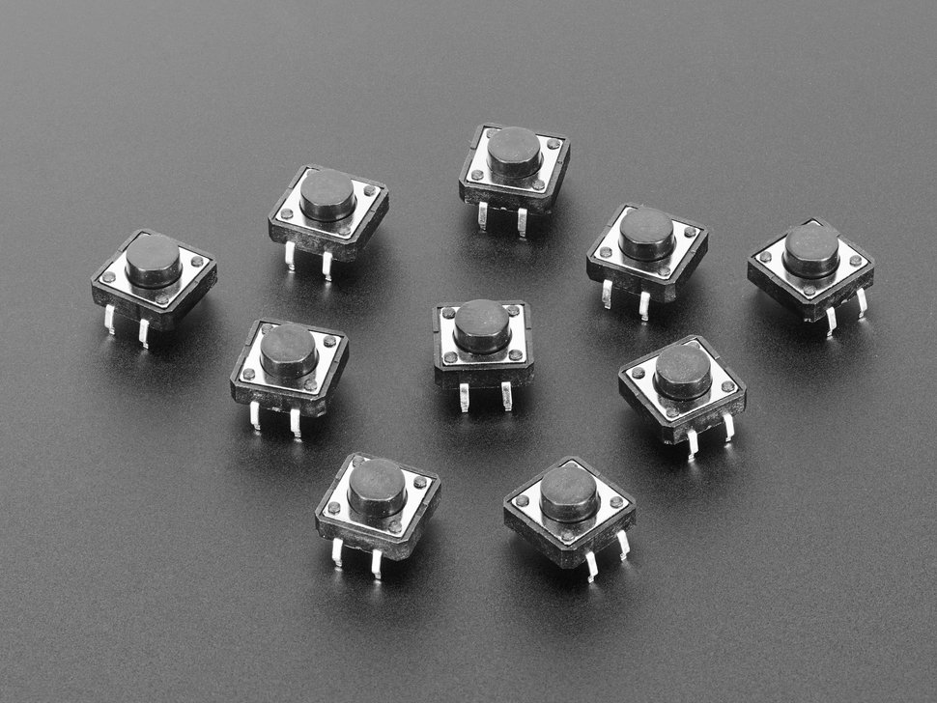
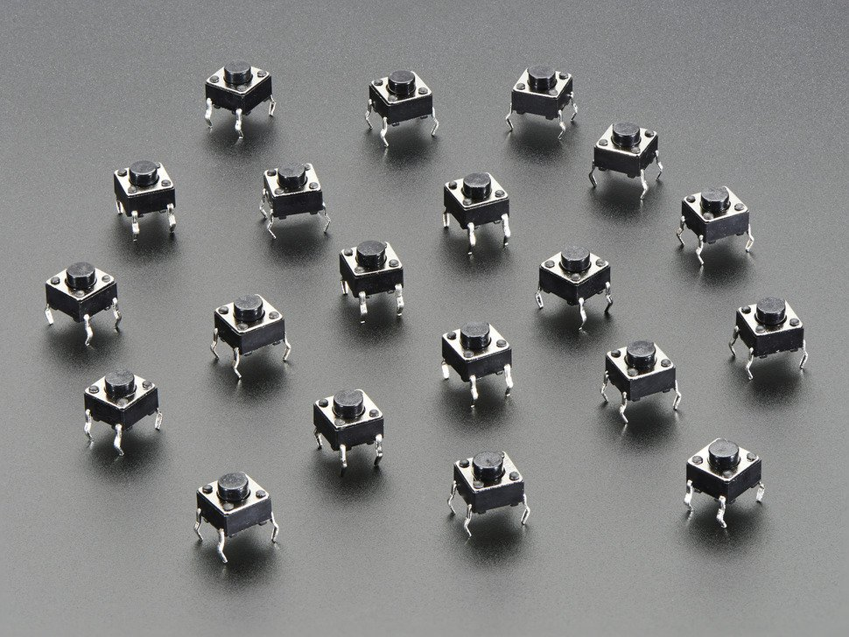
Color Tactile Buttons 1
https://www.sparkfun.com/products/14460
Color Tactile Buttons 2
https://www.sparkfun.com/products/10302
12x12mm Tactile Button Pack
https://www.adafruit.com/product/367
6x6mm Tactile Button Pack
https://www.adafruit.com/product/367

Slide 11
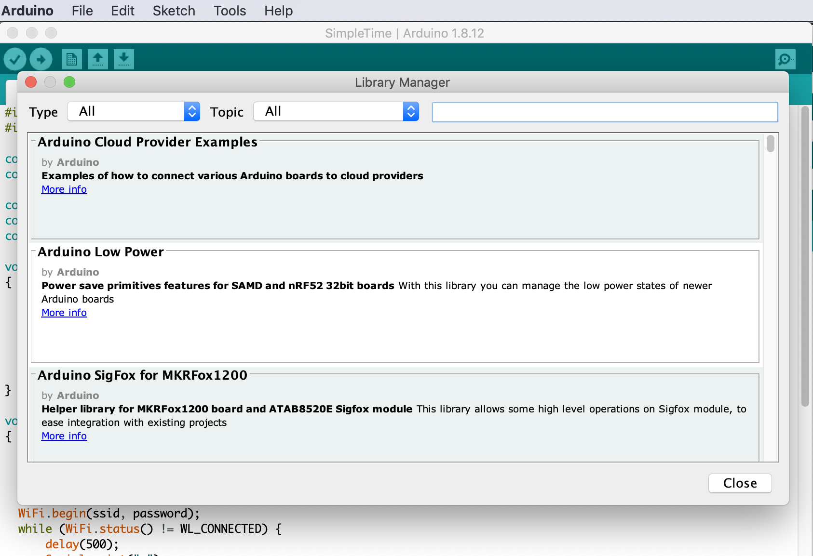

Slide 12
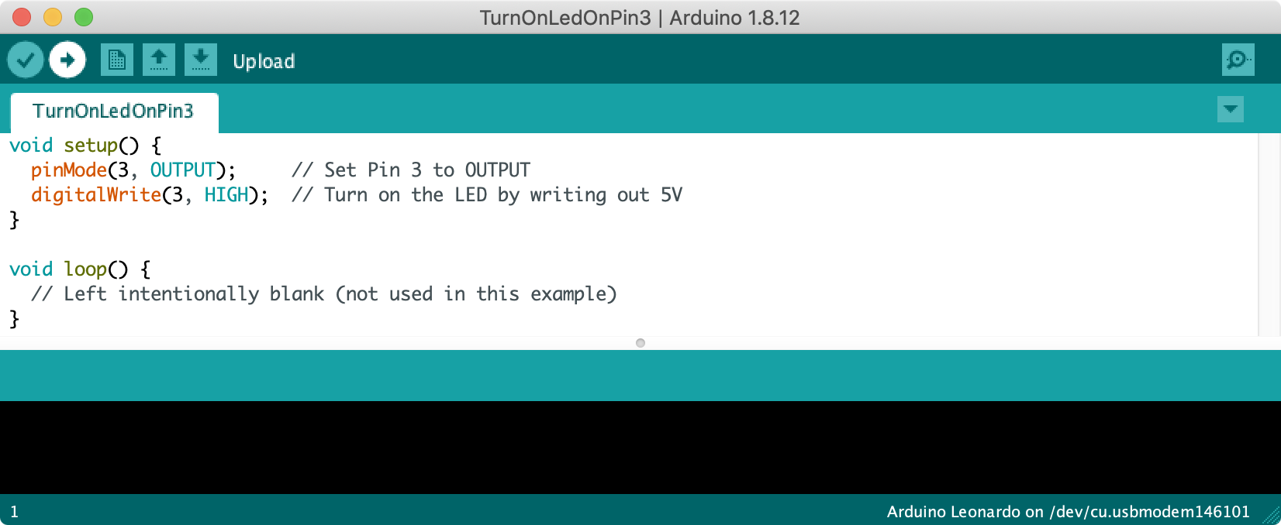
Click this arrow to upload your code. Note: you must first set your Arduino board and port in Tools->Board and Tools->Port, respectively.

Slide 13
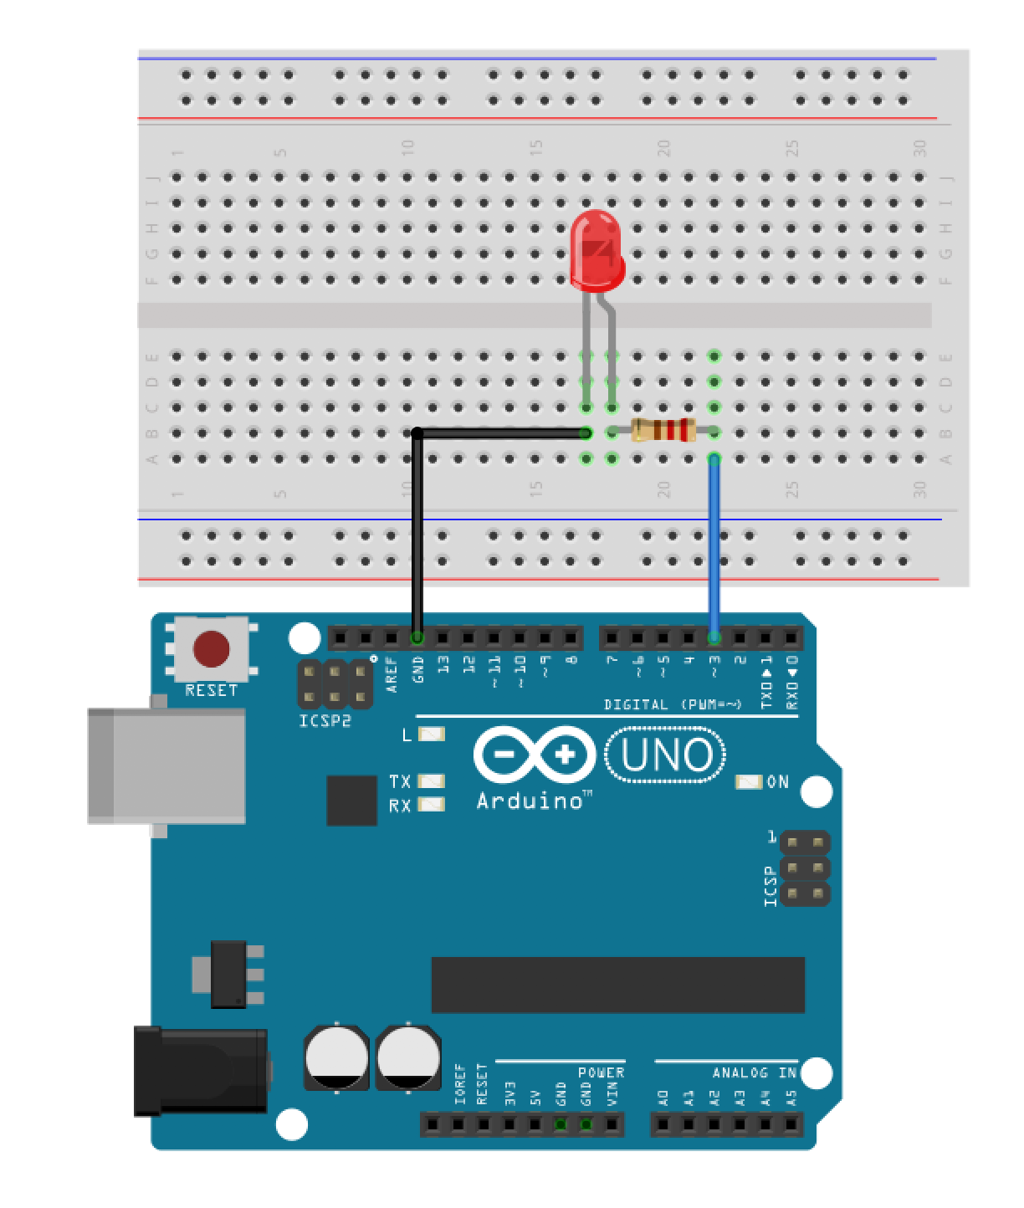
LED Anode

Slide 14
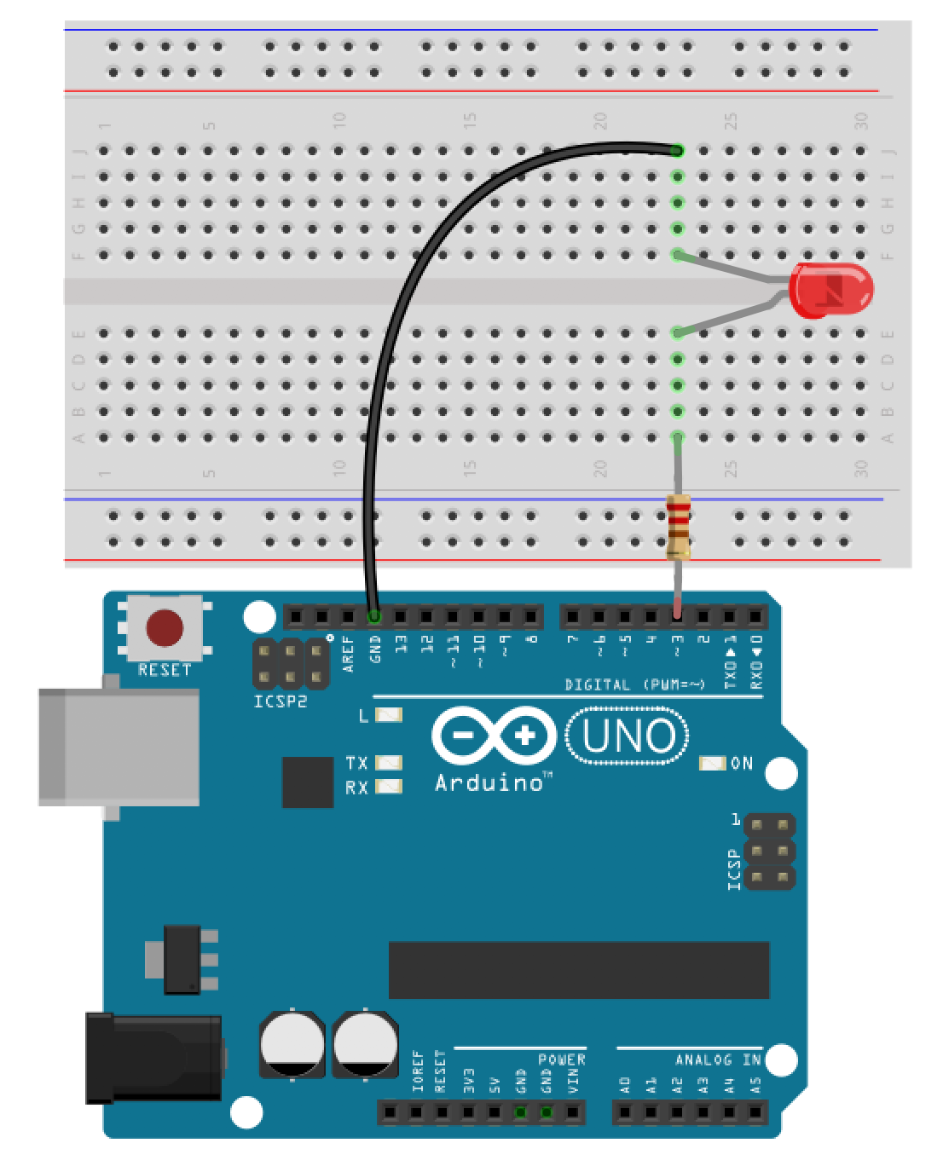
LED Anode

Slide 16
GND
5V
3.3V

Slide 17
Digital I/O Pins
At first glance, the white silkscreening “DIGITAL” seems to indicate that the Arduino Uno has 14 digital input/output (I/O) pins; however,
Six Analog Input Pins
The Arduino Uno has 6 analog input pins, which can read a voltage signal between 0-5V using the analogRead command

Slide 18
Digital I/O Pins
The Arduino Uno has 14 digital input/output (I/O) pins, which can be used to read or write digital information via the digitalRead and digitalWrite commands, respectively.

Slide 19
20 Total Digital I/O Pins
14 Digital I/O Pins
On one side of the board, the Arduino Uno has 14 digital input/output (I/O) pins, which can be used to read or write digital information via the digitalRead and digitalWrite commands, respectively.
Analog Input Pins as Digital I/O Pins
The Arduino Uno’s six analog input pins can also be used as digital I/O pins (thereby getting us to 20 total)

Slide 20
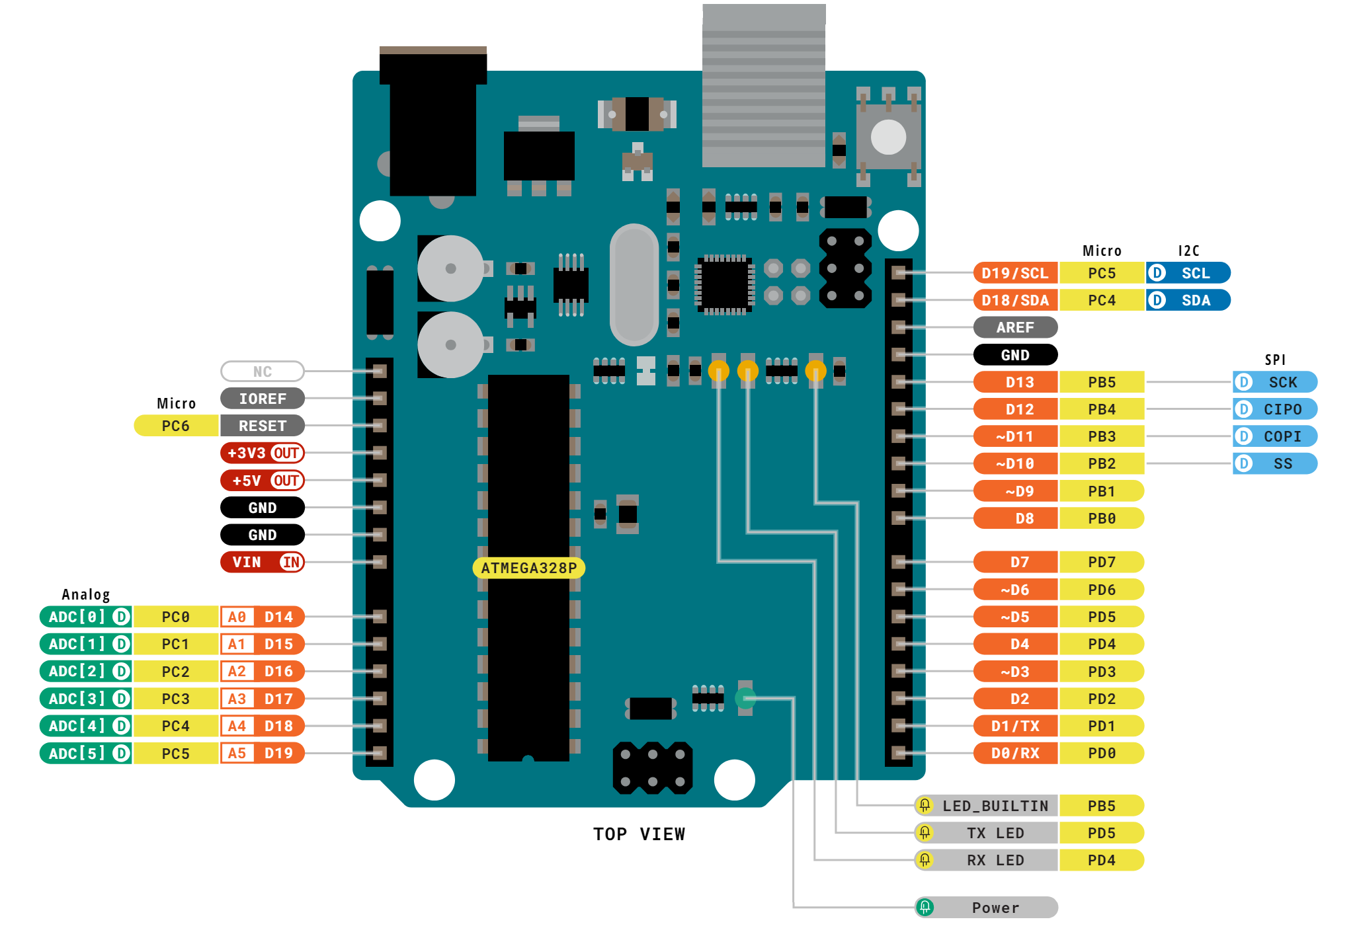
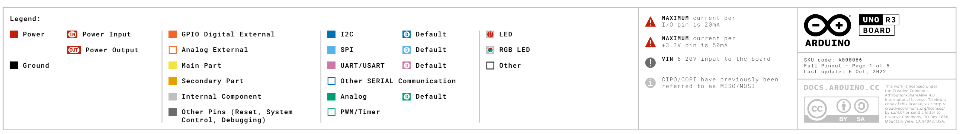
Notes:
https://docs.arduino.cc/resources/pinouts/A000066-full-pinout.pdf

Slide 21
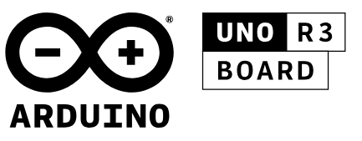
Notes:
https://docs.arduino.cc/resources/pinouts/A000066-full-pinout.pdf

Slide 22
Notes:
https://docs.arduino.cc/resources/pinouts/A000066-full-pinout.pdf

Slide 23
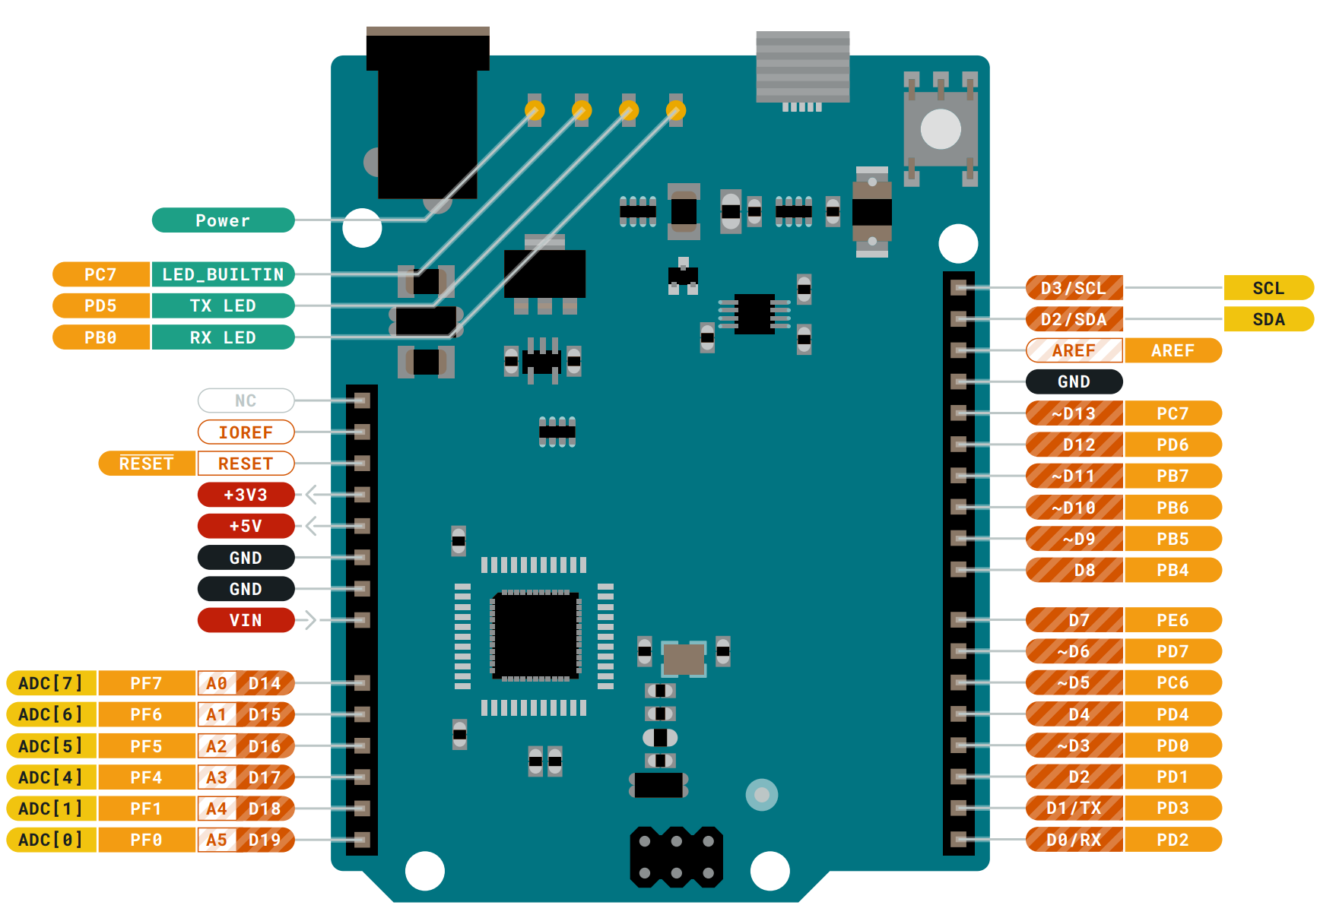
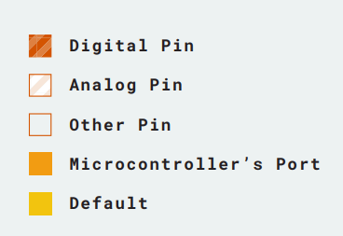
Arduino Leonardo
Notes:
Here’s the official one from Arduino
https://content.arduino.cc/assets/Pinout-Leonardo_latest.pdf

Slide 24
Analog Output Pins
The Arduino Uno has 6 analog output pins indicated by the tilde ~, which can output a voltage signal between 0 and 5V using PWM via the analogWrite command

Slide 25
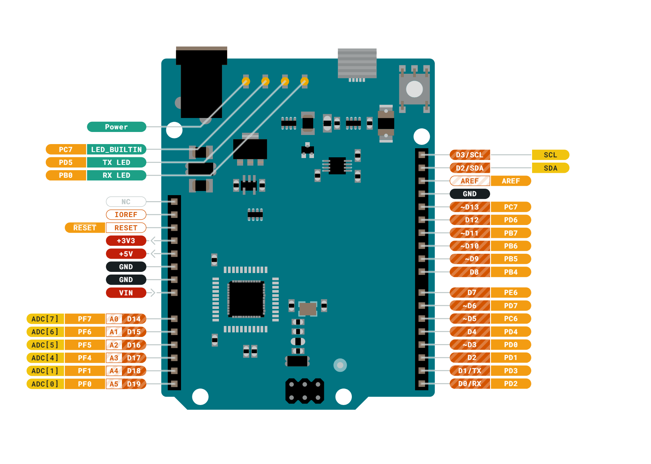
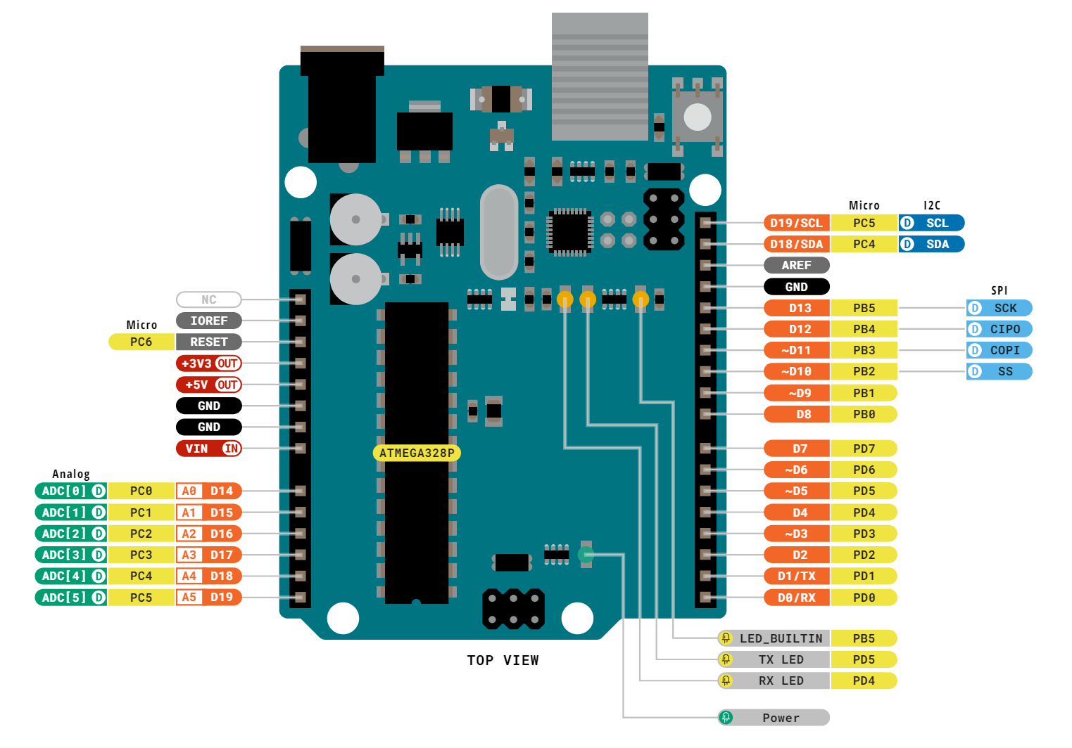
Arduino Uno
Arduino Leonardo
Notes:
Uno: https://content.arduino.cc/assets/A000066-full-pinout.pdf
Leonardo: https://content.arduino.cc/assets/Pinout-Leonardo_latest.pdf

Slide 26
Arduino Uno
Arduino Leonardo
6 PWM pins
7 PWM pins
Notes:
Uno: https://content.arduino.cc/assets/A000066-full-pinout.pdf
Leonardo: https://content.arduino.cc/assets/Pinout-Leonardo_latest.pdf

Slide 27
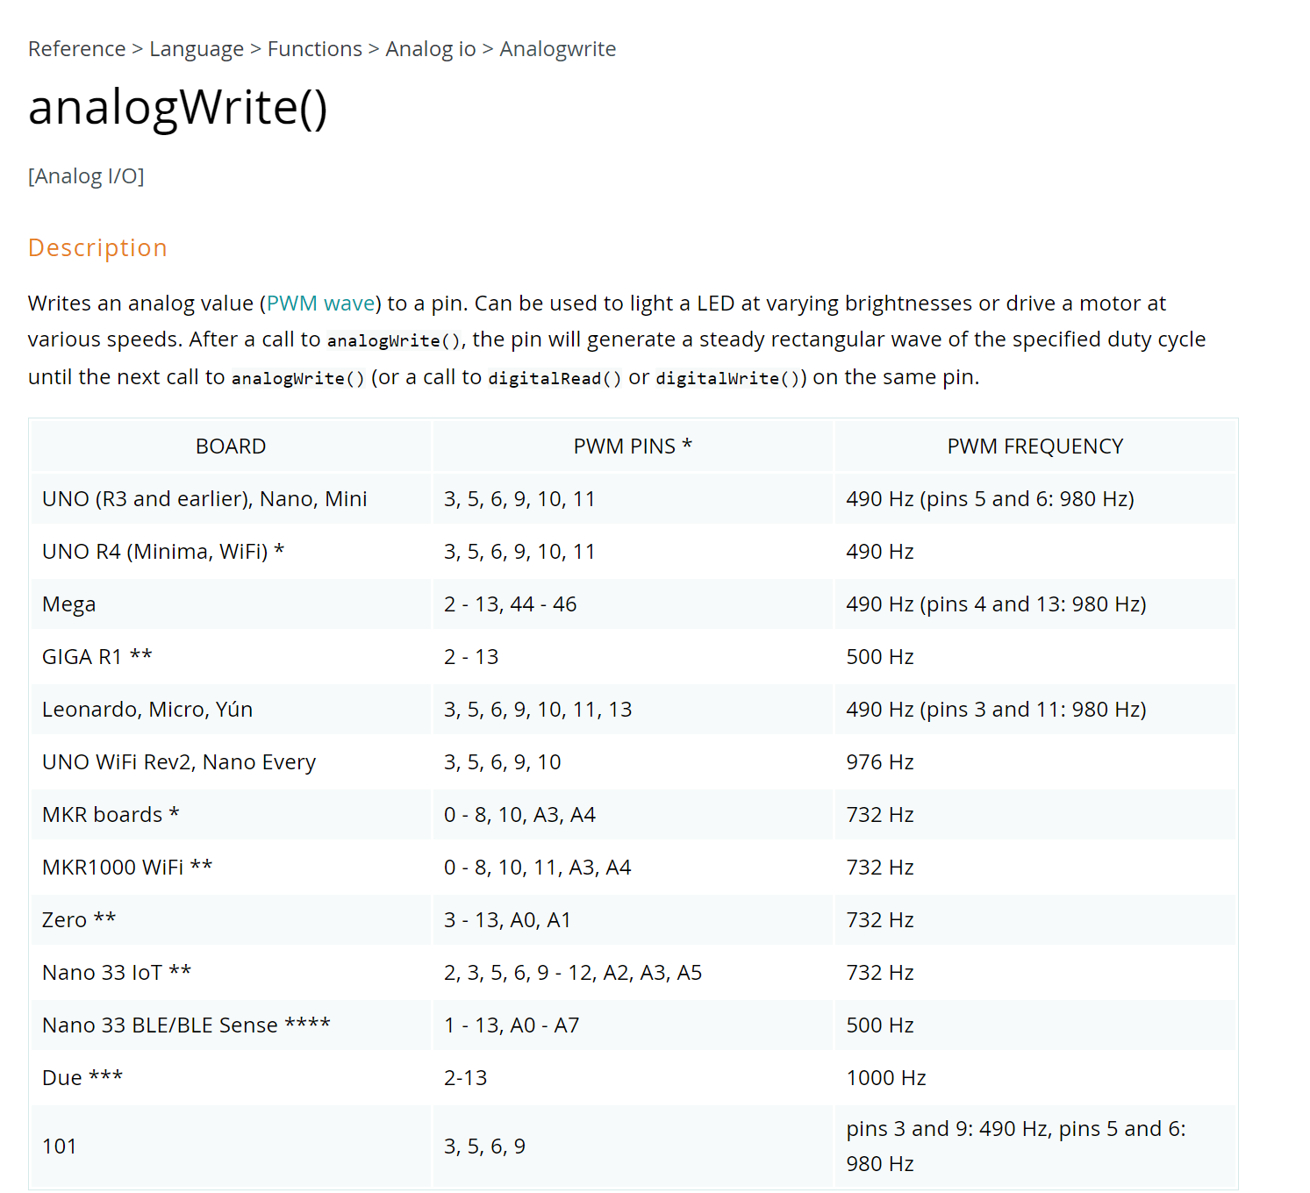
Arduino Uno
Arduino Leonardo
6 PWM pins
7 PWM pins
PWM Freq
490Hz
PWM Freq
980Hz
490Hz
490Hz
980Hz
490Hz
490Hz
980Hz
Notes:
https://www.arduino.cc/reference/en/language/functions/analog-io/analogwrite/
Uno: https://content.arduino.cc/assets/A000066-full-pinout.pdf
Leonardo: https://content.arduino.cc/assets/Pinout-Leonardo_latest.pdf

Slide 28
Controllable Built-In LED
Many Arduinos have a built-in LED (specified by the LED_BUILTIN constant) that’s controllable like any other LED with digitalWrite and digitalWrite calls. On the Arduno Uno and Leonardo, the built-in LED is here.

Slide 29
Six Analog Output Pins
The Arduino Uno has 6 analog output pins indicated by the tilde ~, which can output a voltage signal between 0 and 5V using PWM via the analogWrite command
Six Analog Input Pins
The Arduino Uno has 6 analog input pins, which can read a voltage signal between 0-5V using the analogRead command

Slide 30

Six Analog Output Pins
The Arduino Uno has 6 analog output pins indicated by the tilde ~, which can output a voltage signal between 0 and 5V using PWM via the analogWrite command
Beginners often confuse the analog output pins with the analog input pins. They’re different!
Six Analog Input Pins
The Arduino Uno has 6 analog input pins, which can read a voltage signal between 0-5V using the analogRead command

Slide 31
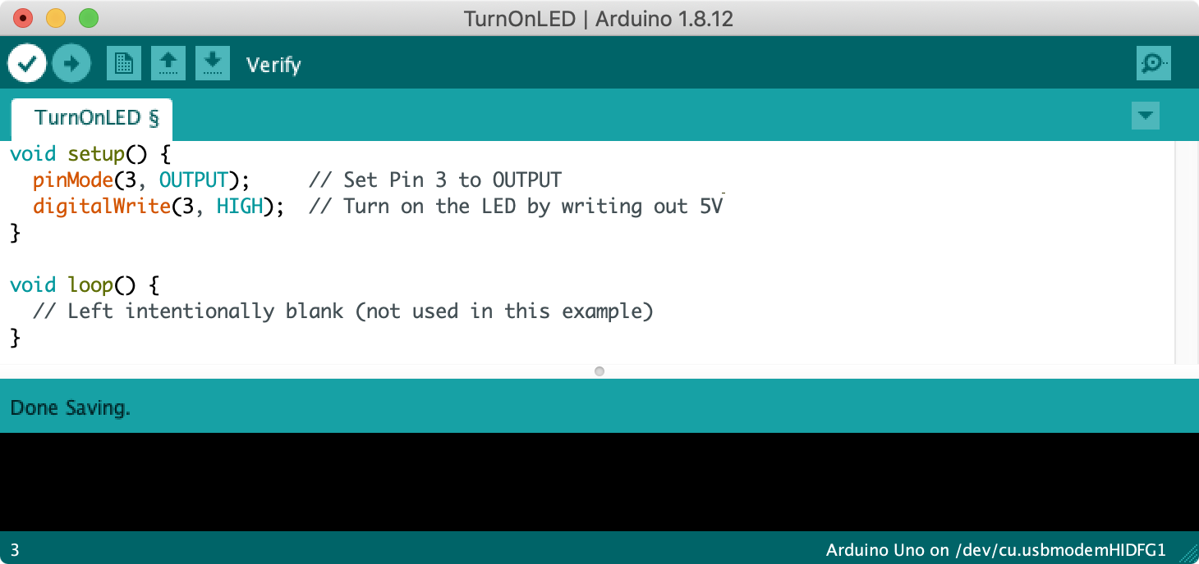
Digital I/O Pins
The Arduino Uno has 14 digital input/output (I/O) pins, which can be used to read or write digital information via the digitalRead and digitalWrite commands, respectively.

Slide 32
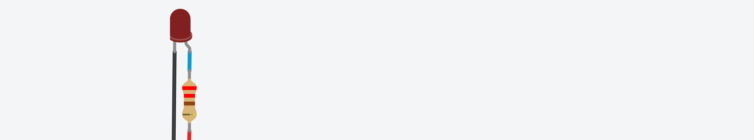

Slide 33
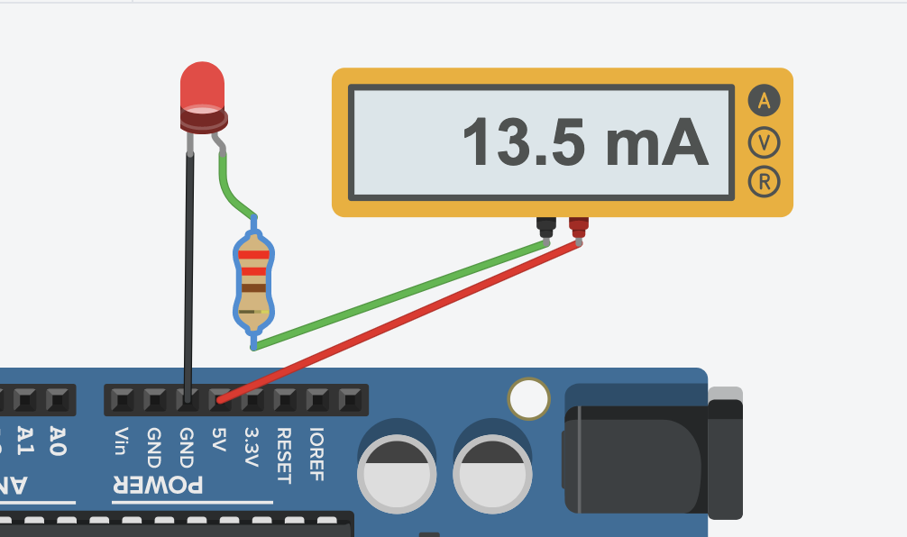

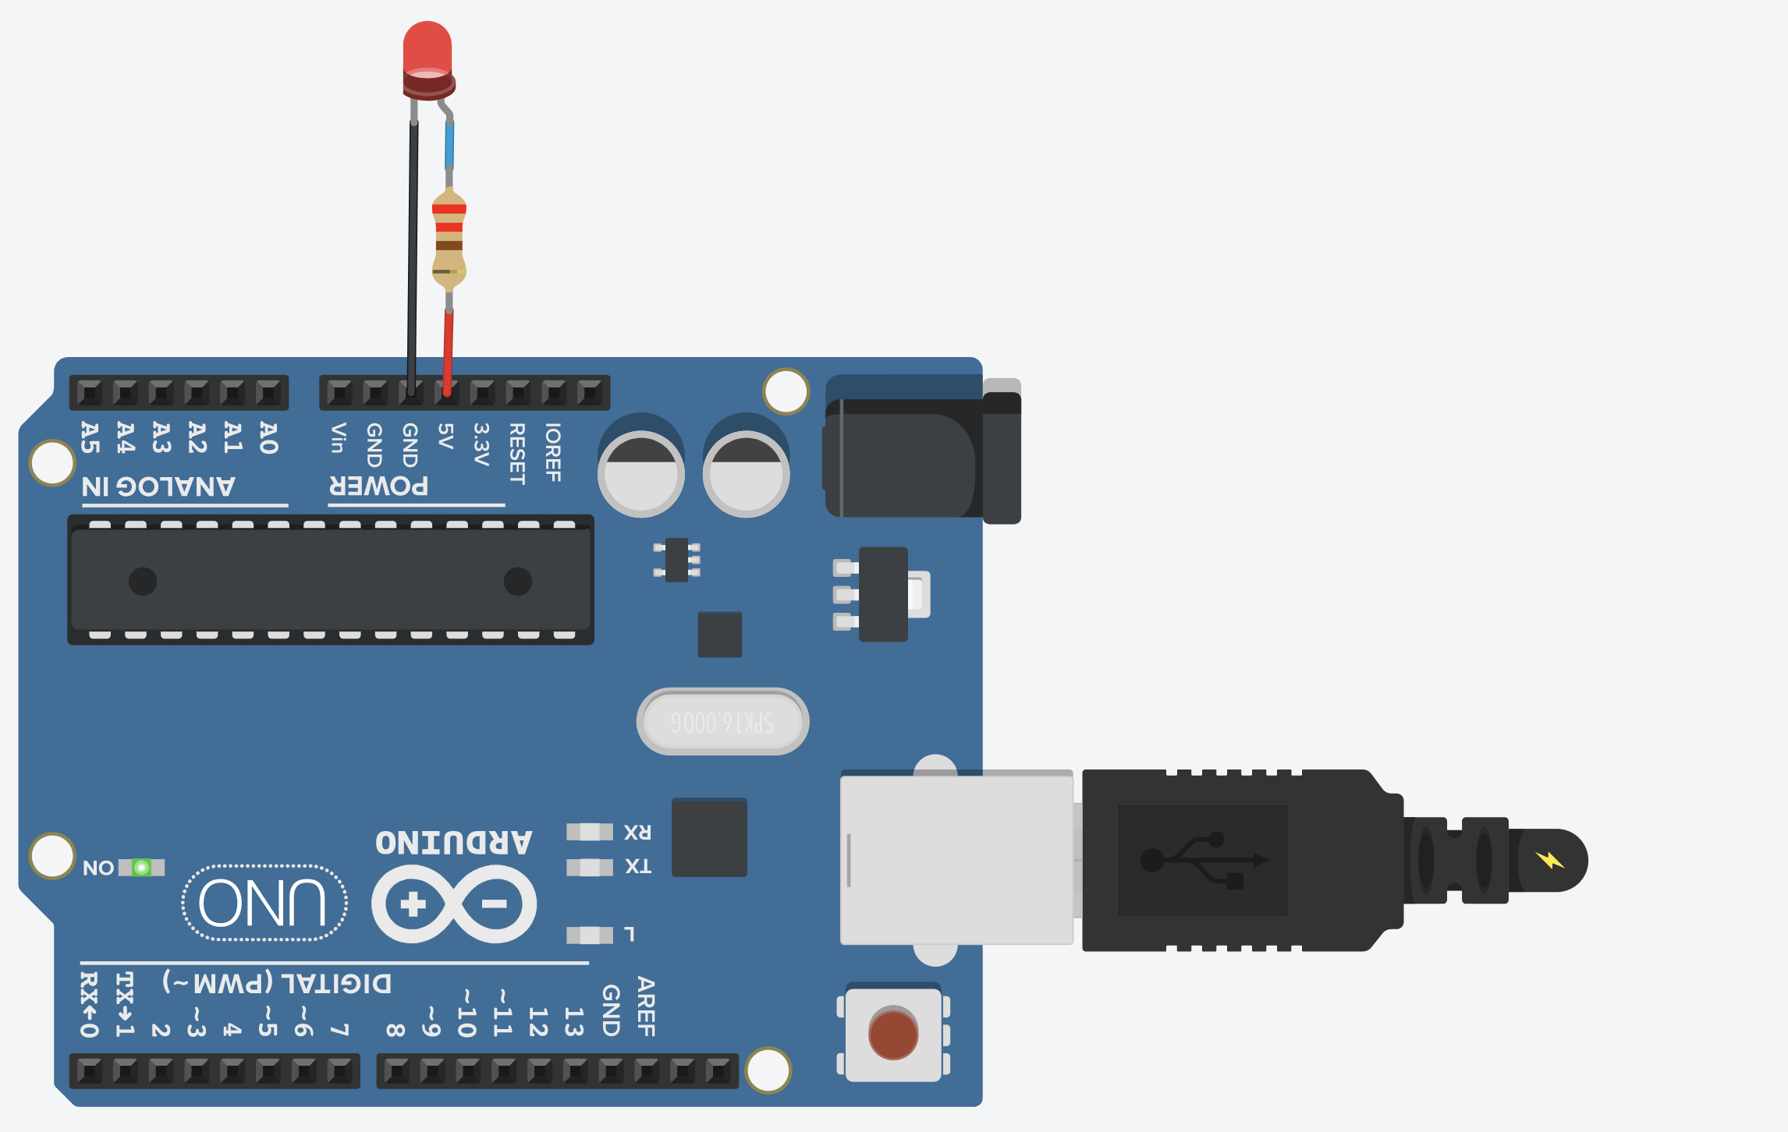

Slide 34
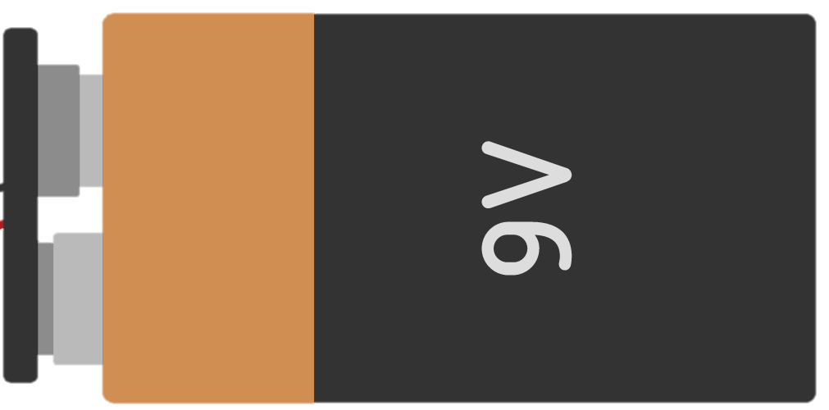
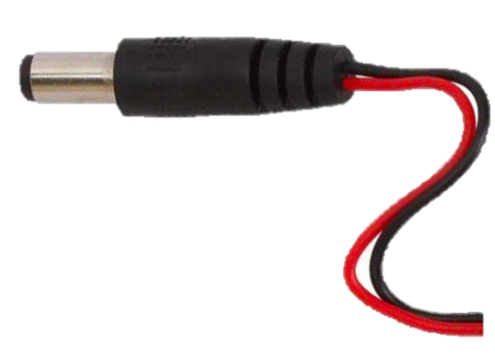

Slide 35
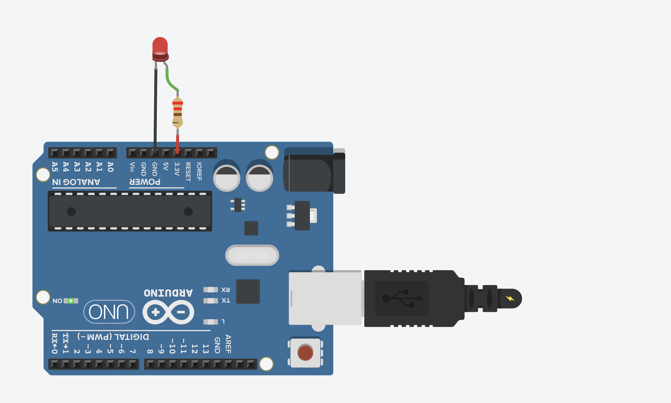
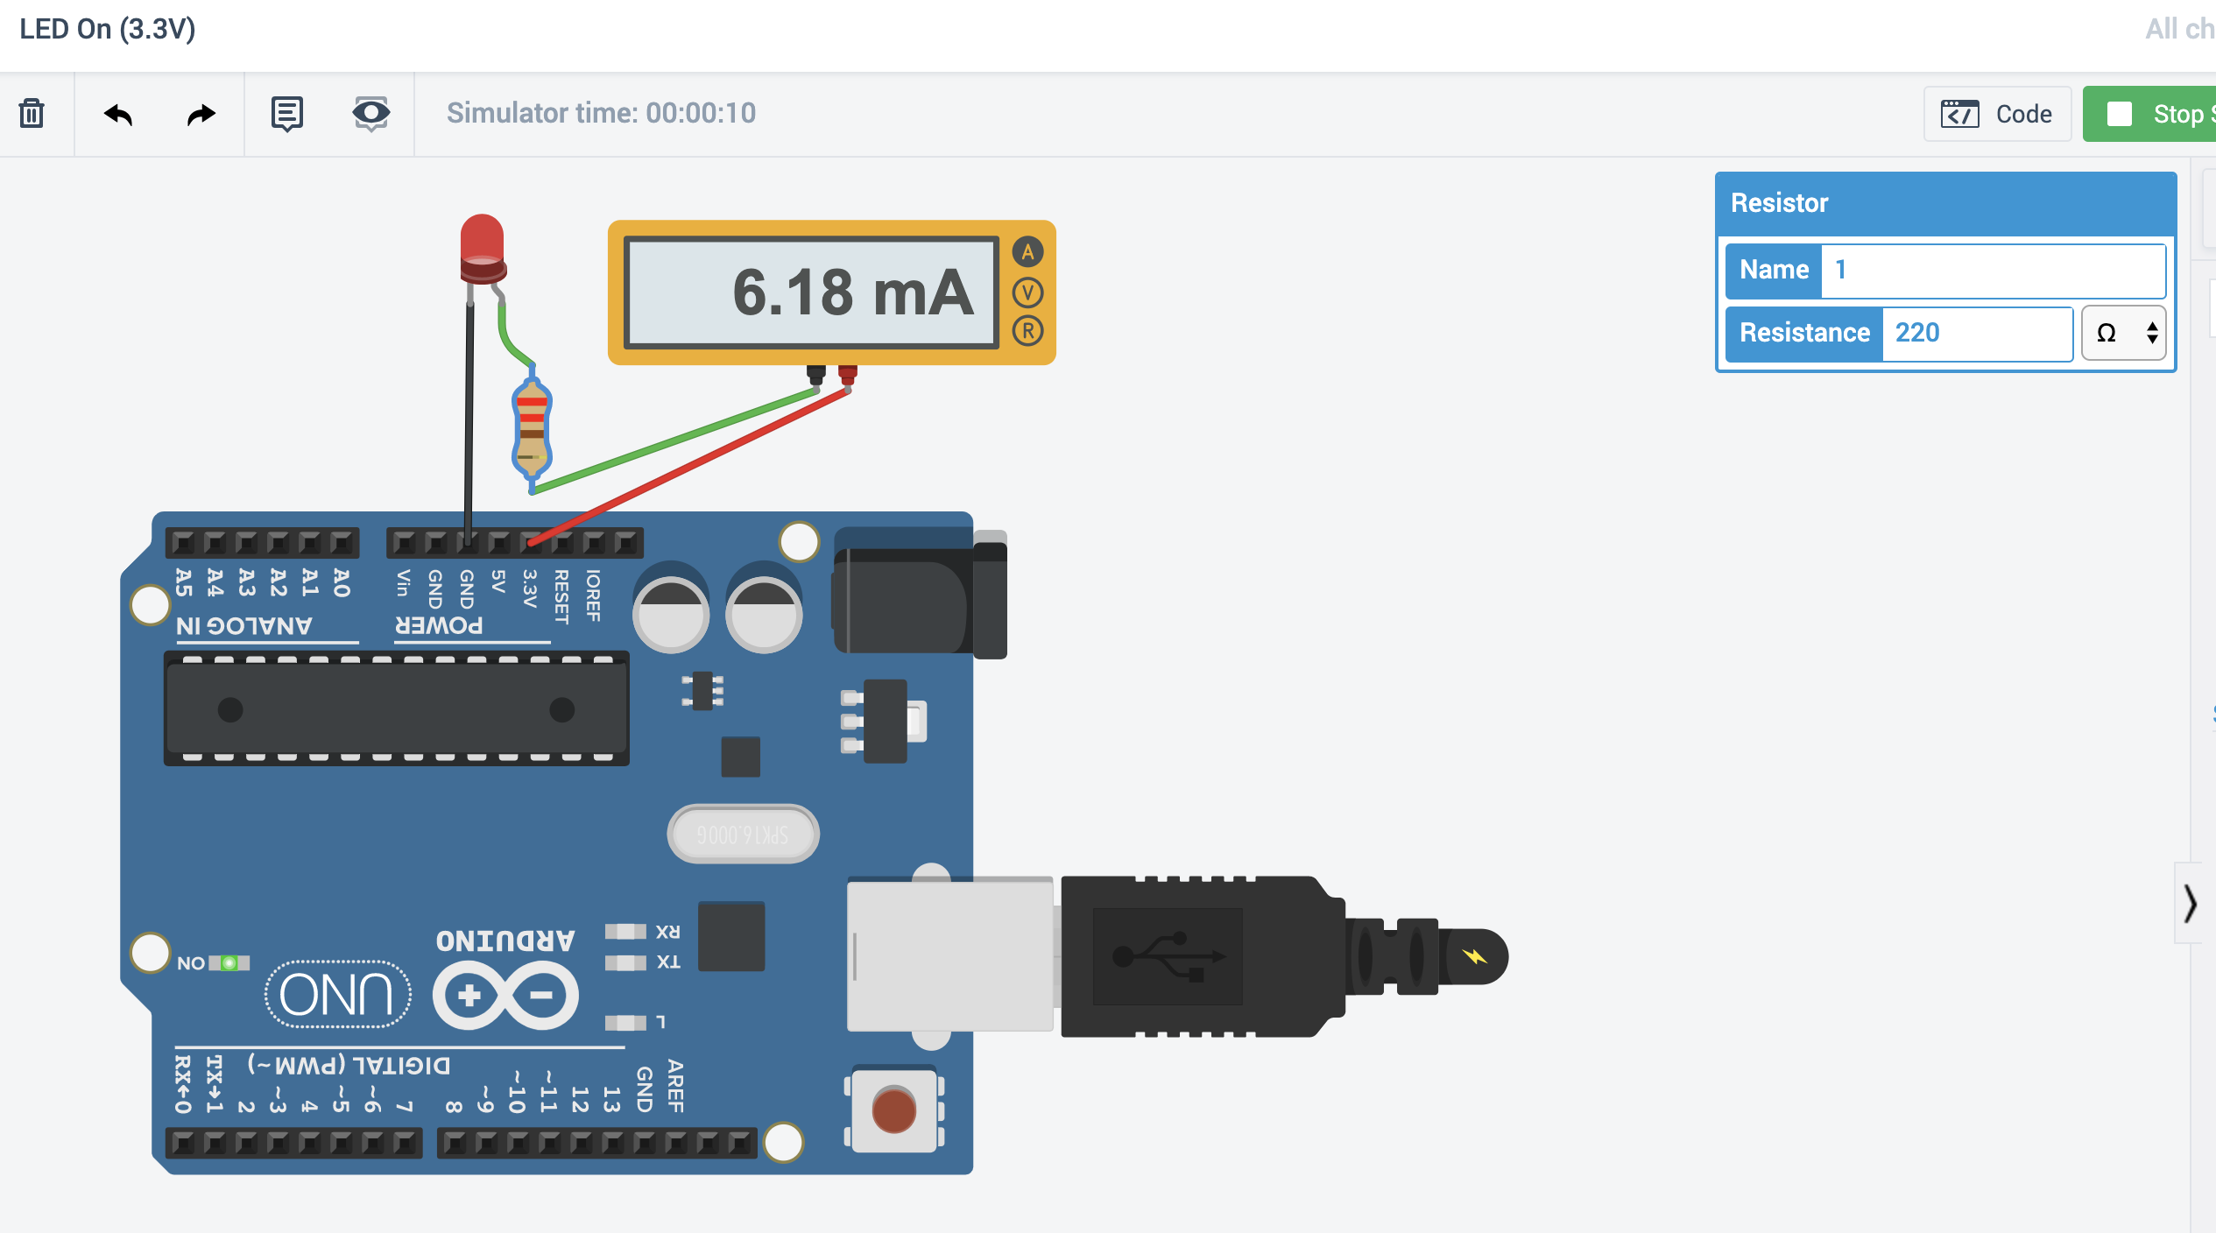
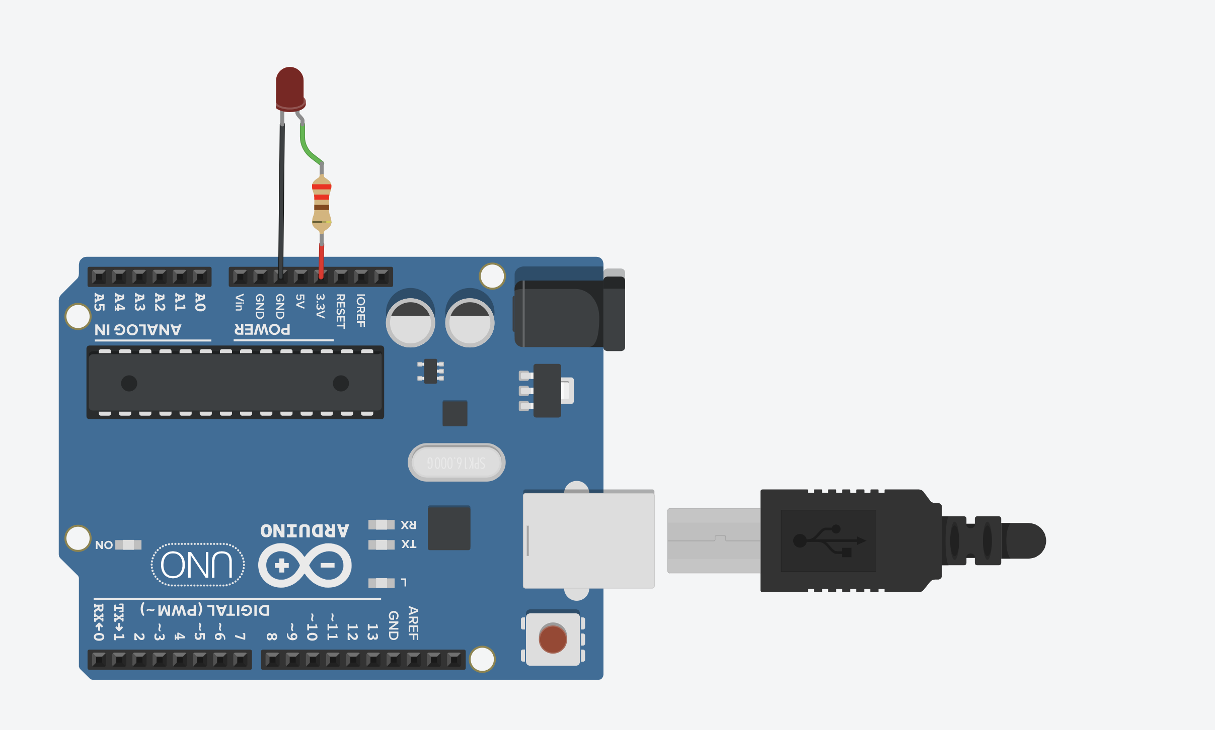
220Ω

Slide 37
LED On
Show LED built-in example?
Show breadboard variant?

Slide 38
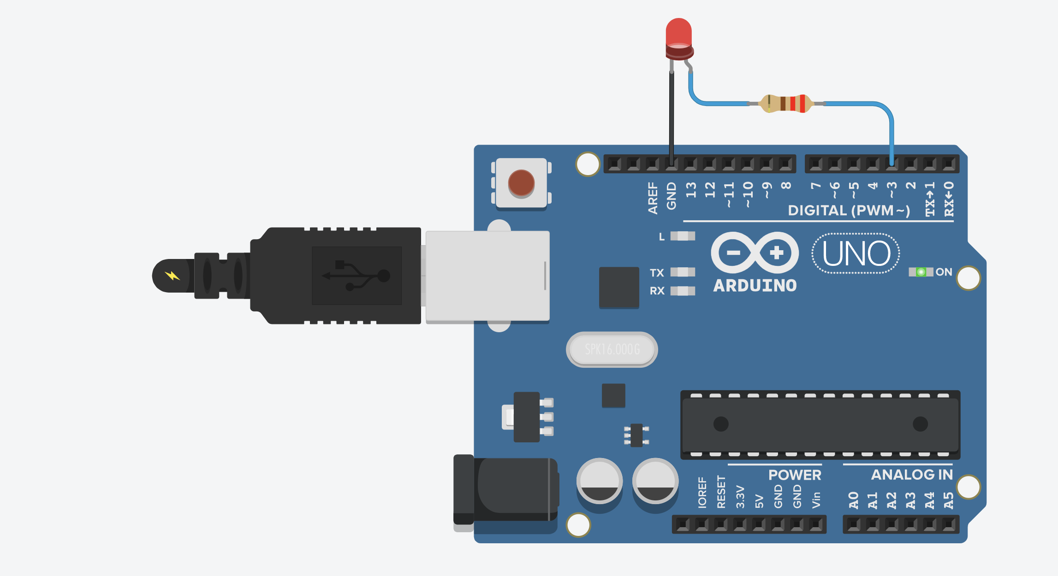
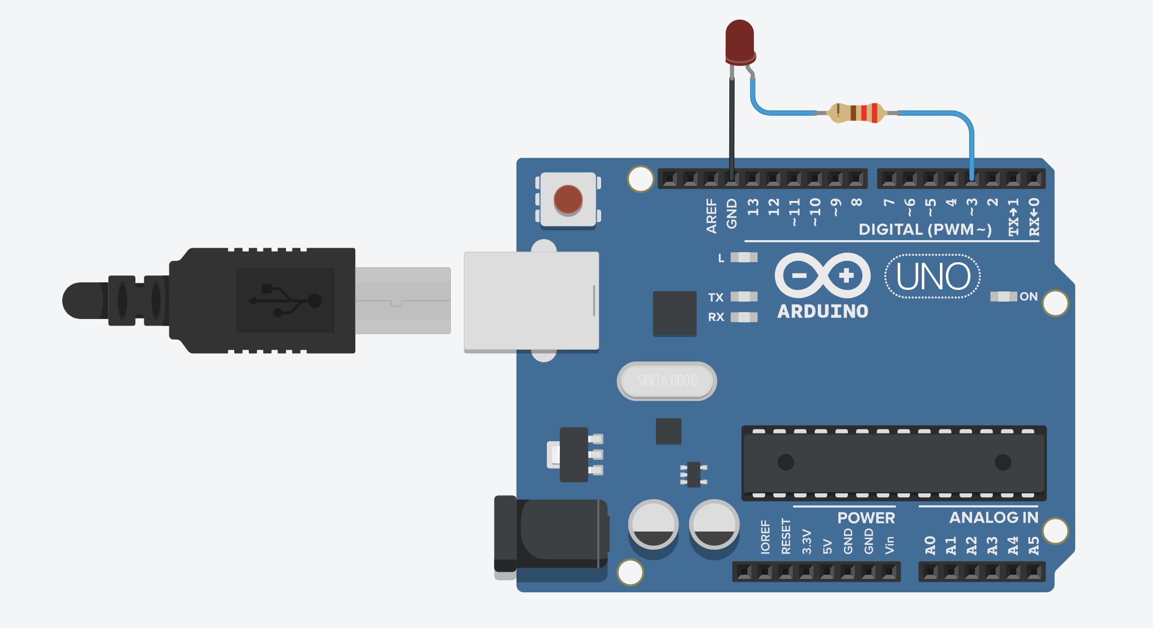
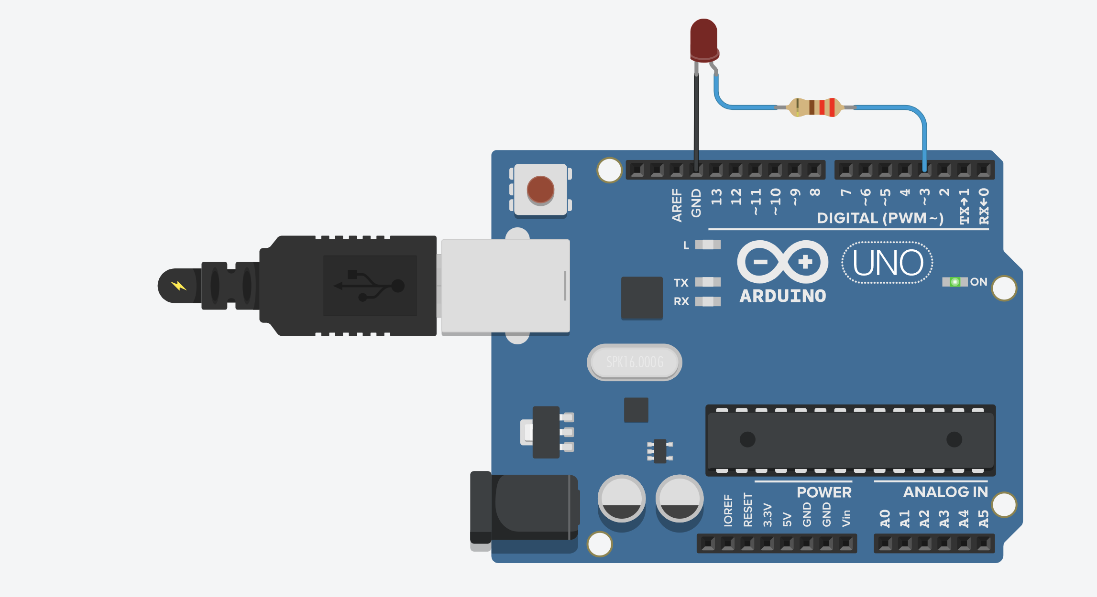

Slide 39
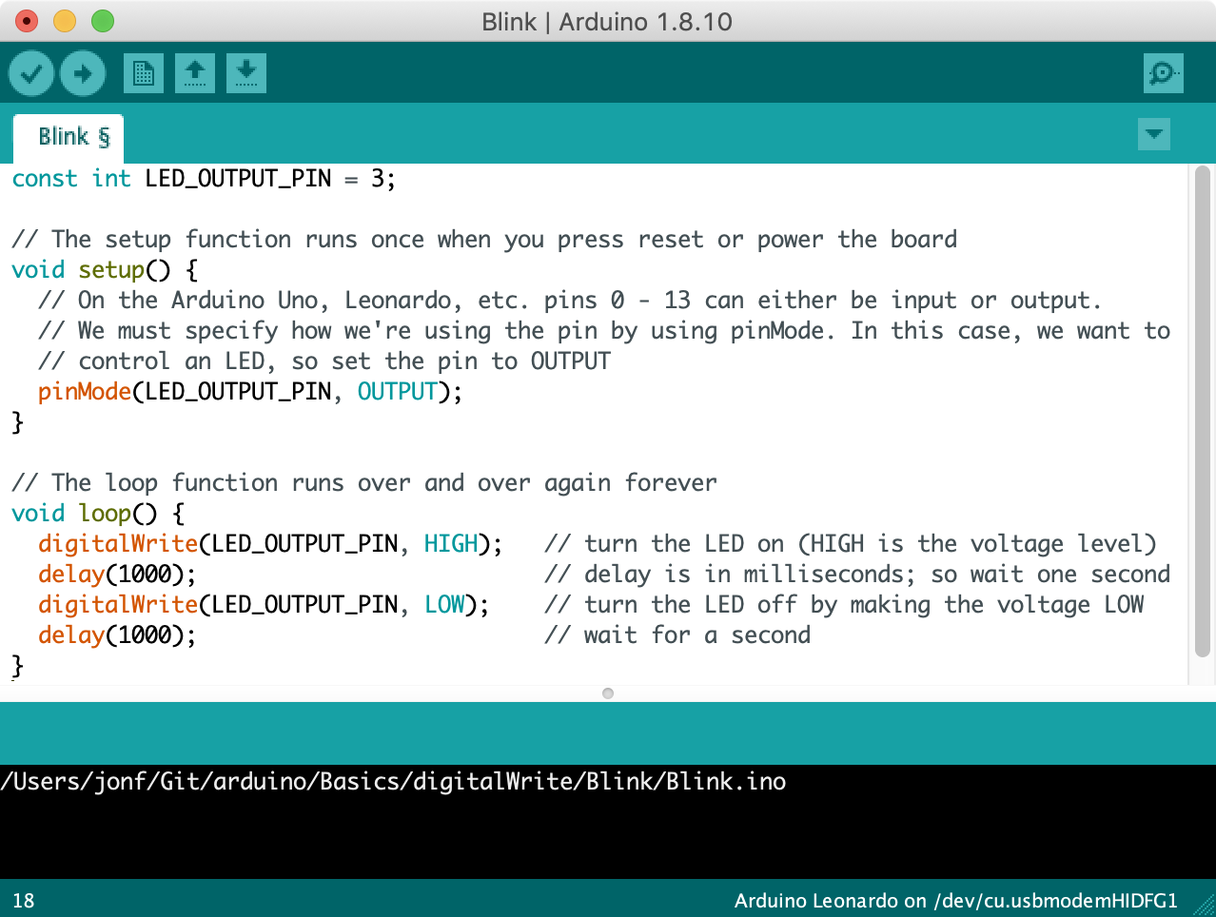
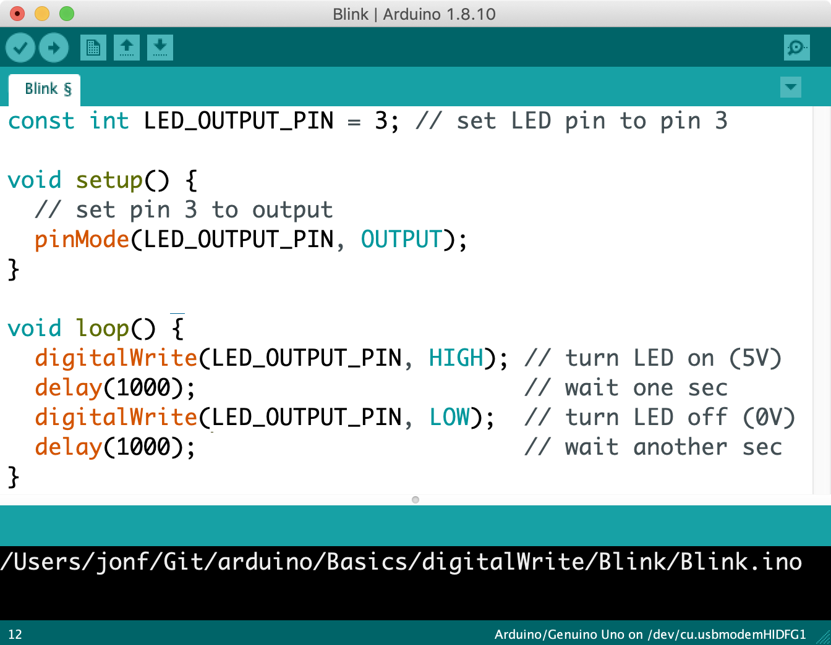

Slide 40
Arduino powered on
setup() is called immediately once and only once. Put your initialization code here.
Run initial setup() code
Pins 0 – 13 can be either input or output. Set Pin 3 to output to control the connected LED.
After setup(), loop() is called
After setup() completes, loop() is called automatically. When loop() ends, it is run again and again (until the Arduino is shut off or reprogrammed)
digitalWrite(3, HIGH)
Output a HIGH signal (5V) on Pin 3 and then wait for one second
digitalWrite(3, LOW)
Output a LOW signal (0V) on Pin 3 and then wait for one second
End of loop(), call loop() again
When loop() ends, it is called again automatically. This loop continues forever.
Notes:
The program running on the Arduino, which continuously alternates between outputting 5V on Pin 3 for one second and outputting 0V.

Slide 41
Arduino powered on
setup() is called immediately once and only once. Put your initialization code here.
Run initial setup() code
Pins 0 – 13 can be either input or output. Set Pin 3 to output to control the connected LED.
After setup(), loop() is called
After setup() completes, loop() is called automatically. When loop() ends, it is run again and again (until the Arduino is shut off or reprogrammed)
digitalWrite(3, HIGH)
Output a HIGH signal (5V) on Pin 3 and then wait for one second
digitalWrite(3, LOW)
Output a LOW signal (0V) on Pin 3 and then wait for one second
End of loop(), call loop() again
When loop() ends, it is called again automatically. This loop continues forever.
Notes:
The program running on the Arduino, which continuously alternates between outputting 5V on Pin 3 for one second and outputting 0V.

Slide 42
Arduino powered on
setup() is called immediately once and only once. Put your initialization code here.
Run initial setup() code
Pins 0 – 13 can be either input or output. Set Pin 3 to output to control the connected LED.
After setup(), loop() is called
After setup() completes, loop() is called automatically. When loop() ends, it is run again and again (until the Arduino is shut off or reprogrammed)
digitalWrite(3, HIGH)
Output a HIGH signal (5V) on Pin 3 and then wait for one second
digitalWrite(3, LOW)
Output a LOW signal (0V) on Pin 3 and then wait for one second
End of loop(), call loop() again
When loop() ends, it is called again automatically. This loop continues forever.
Notes:
The program running on the Arduino, which continuously alternates between outputting 5V on Pin 3 for one second and outputting 0V.

Slide 44
LED On
Show LED built-in example?
Show breadboard variant?

Slide 45
Screenshot tips on mac
Hit Cmd-Shift-5
When screenshooting full window, hold option when over a window to disable the dropshadow

Slide 46
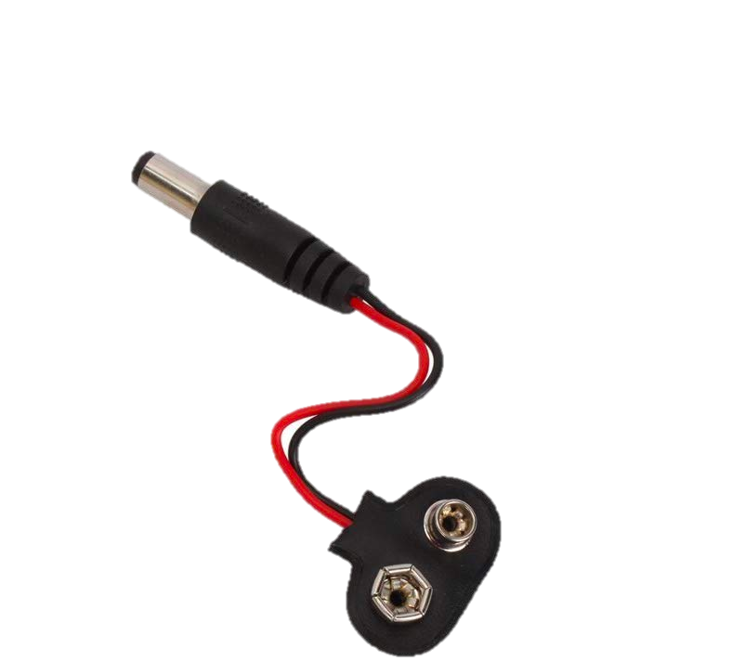

Slide 47
Notes:
https://support.office.com/en-us/article/make-an-animated-gif-from-a-slide-show-a598753e-92de-4f1b-8393-714db4d334b4

